Slide 1


GRUPO 4
GARDENING
ROBOT
Solugarden – Advanced Manufacturing Technology
Alecsander Melo Nunes da Silva
Carlos Augusto Kice
Gabriel Ricardo da Silva
Jacson Sena Reis
FATEC São Bernardo do Campo | June 2026

Slide 2
TABLE OF CONTENTS
01
Introduction & Solugarden Company
05
Team Management
02
Product Description – Gardening Robot
06
Personal Branding
03
Factory Project – Design Thinking
07
Automated Systems II – Elevated Conveyor
04
Layout Optimization – Bakery
08
Quality Control & Processes

Slide 3
SOLUGARDEN
About the Company
Fictional company created to integrate knowledge from the Advanced Manufacturing program at FATEC SBC. Develops autonomous gardening robots for green area maintenance in condominiums and commercial spaces.
Mission
Objective
Technological solutions for automation of green areas, promoting efficiency and safety.
Autonomous robots that mow with precision, reducing manual labor and occupational risks.
Application
Differentials
Residential condominiums – with projected expansion to industrial scale.
100% electric delivery vehicles; real-time data via Azure cloud.

Slide 4





PRODUCT DESCRIPTION
Chassis & Drive
Electronics
Metal + ABS/PA thermoplastic. Two DC drive wheels with gearbox + free wheel. Supports up to 30–40% inclines.
Arduino/Raspberry Pi MCU. H-bridge motor drivers. Bluetooth/Wi-Fi. OTA firmware updates.
Cutting System
Sensors
Rotary discs with hardened steel blades. Height 20–50 mm, bidirectional. Cutting width: 22 cm.
Ultrasonic + IR obstacle detection, cliff sensors, tilt sensor, front bumper + perimeter boundary wire.
Battery & Performance
Software
60 min cutting / ~60 min recharge. Li-Ion 20V 5Ah. Cut precision >90%. Weight ~10 kg.
Probabilistic navigation, spiral sweep, terrain mapping via odometry. App control + scheduling.

Slide 5
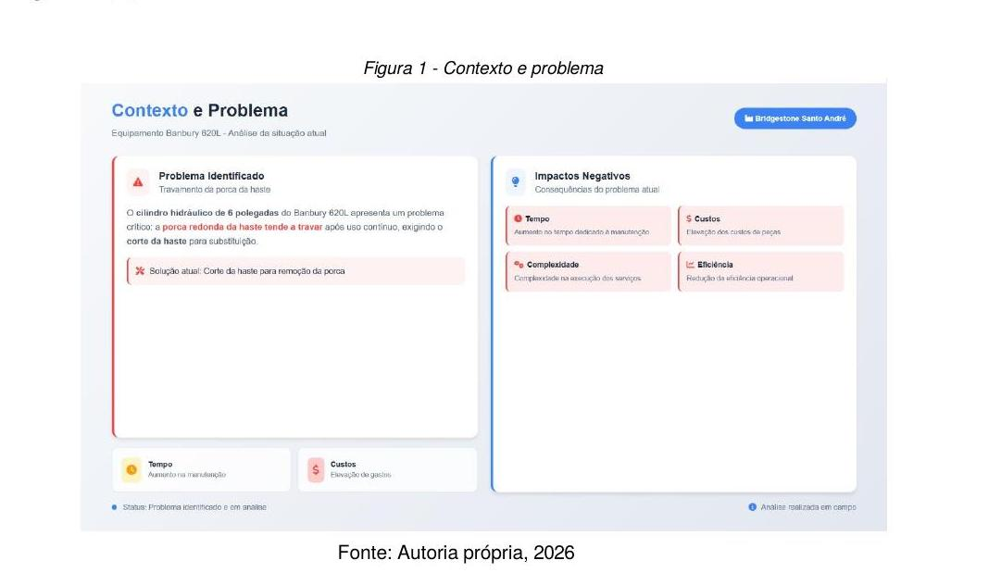
DESIGN THINKING – FACTORY PROJECT
Applied to reduce corrective maintenance time on hydraulic equipment at Solugarden's partner supplier.
1
Empathy
Real maintenance observation; physical wear, risks, unproductive downtime.
2
Definition
Progressive jamming of hydraulic rod locking nut identified as root cause.
3
Ideation
Split block + permanent fixed nut on rod.
4
Prototyping
CNC-machined Steel 1045 components.
5
Testing
Reduced time, safer disassembly, no rod cutting needed.

Slide 6
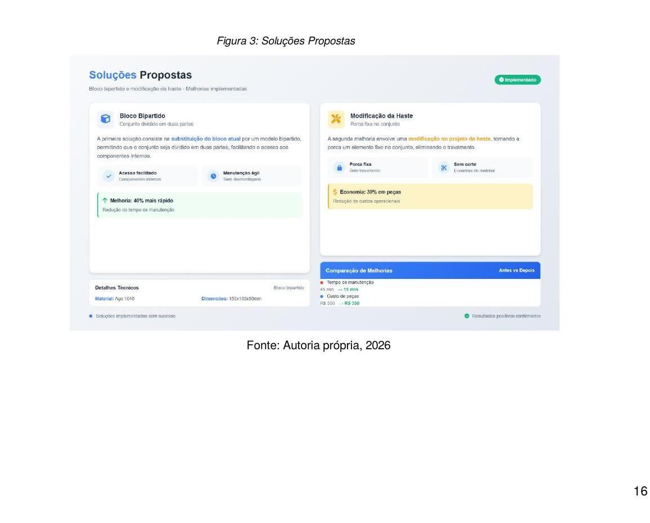
RESULTS – DESIGN THINKING
↓ 60%
Maintenance Time Reduction
↓ 30%
Component Replacement Cost
↑ 95%
Operational Reliability
↑ +
Equipment Availability & Supply Continuity

Slide 7
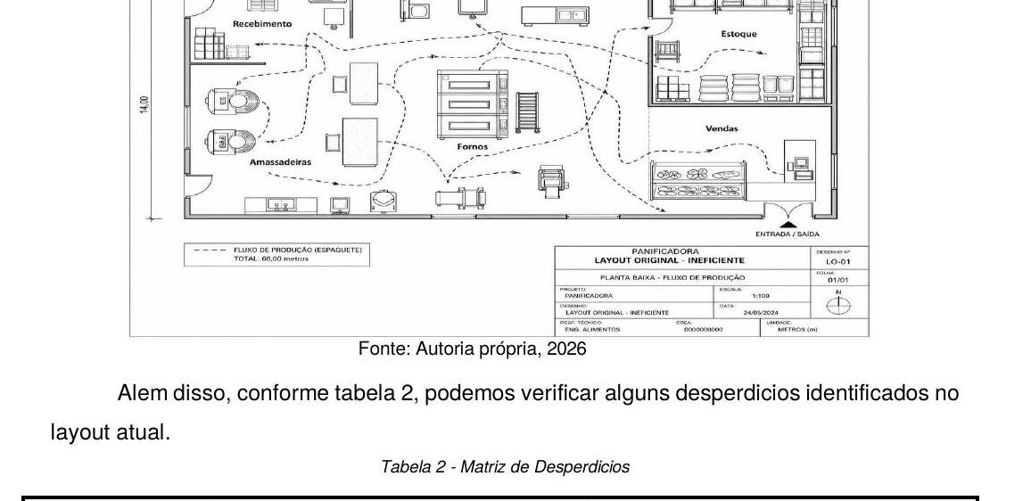
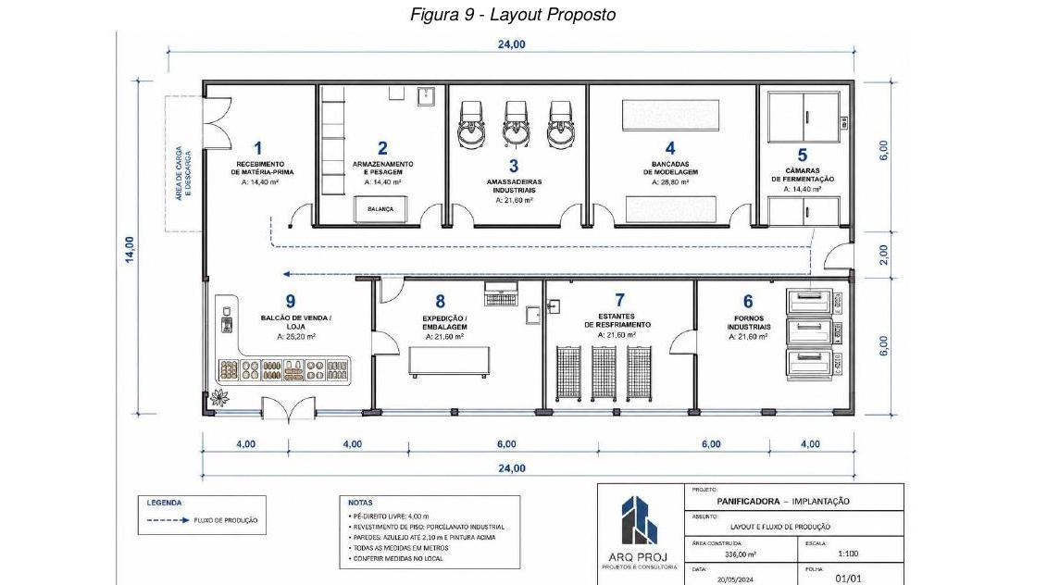
LAYOUT OPTIMIZATION – BAKERY
Company X – Campinas/SP | 336 m² | 18 employees | Revenue: R$ 120,000/month | ~140 active SKUs
BEFORE – Spaghetti Flow
AFTER – U-Shaped Cell Layout
→
Wastes Identified: Transport (contamination risk) • Waiting (cooling shelves) • Movement (long distances) • Defects (12.4% dough loss)
Standards: ANVISA RDC 2016/2004 | NR-12 (Machine Safety) | NR-17 (Ergonomics)

Slide 8
RESULTS – U-SHAPED LAYOUT
Indicator (KPI)
Before
After
Gain
Distance per Batch
68 m
24 m
–64.7%
Lead Time
260 min
158 min
–39.2%
Loss / Defect Index
12.4%
< 5.0%
–59.6%
OEE (Overall Efficiency)
62%
80%
+29.0%
Monthly Inventory Turnover
2.3×
5.0×
+117.4%
U-shaped rearrangement + Lean practices → agility during demand peaks and reduced operator fatigue.

Slide 9

TEAM MANAGEMENT
Organizational structure of Solugarden focused on leadership, SMART goals and people development.
Org Chart
SMART Goals
Distribution of roles and responsibilities by department.
Clear hierarchy between board, managers, and employees.
Defined by sector/department.
Deadlines, owners, and priority levels established.
HR Indicators
Performance Evaluation
Absenteeism (target: <4%)
Turnover (target: <10% p.a.)
GPTW Trust Index (target: ≥70%)
Scale 1–5 by behavioral competencies.
Individual Development Plan (PDI) with clear goals and deadlines.

Slide 10
PERSONAL BRANDING
Survey of the most highlighted competencies and values by group members throughout the Solugarden project.
Professional Ethics
100%
Interpersonal Communication
95%
Emotional Intelligence
93%
Proactivity
92%
Teamwork
90%
These competencies were identified through keyword analysis across group members' self-assessments during the Solugarden project development.

Slide 11
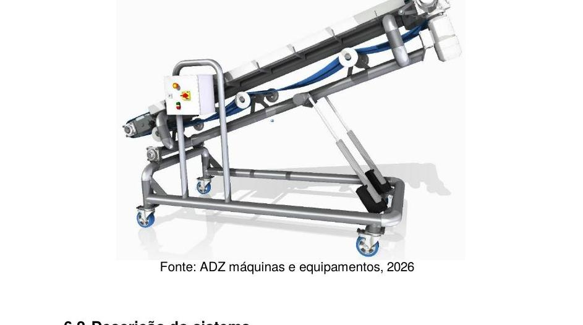
AUTOMATED SYSTEMS II – ELEVATED CONVEYOR
System Specifications
Length:
2,744 mm
Max. Elevation:
1,840 mm
Operating Pressure:
6 bar (0.6 MPa)
Cylinders:
2× SMC CDA2D100-600Z (double-action)
Valve:
5/2-way, dual solenoid – SY5120-5DZ
Control:
PLC 24VCC (Schneider TM172)
Force – Advance:
4,712.4 N
Source: ADZ Máquinas e Equipamentos, 2026
Force – Retract:
4,417.9 N

Slide 12
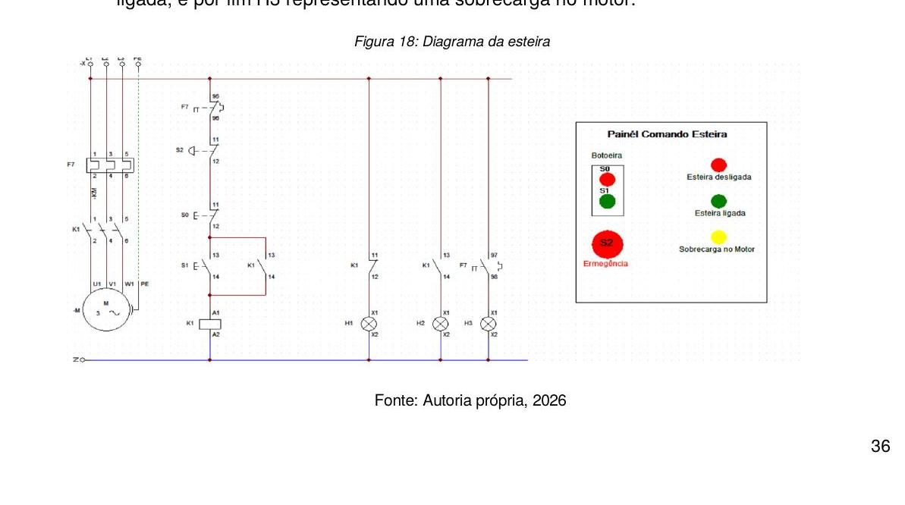
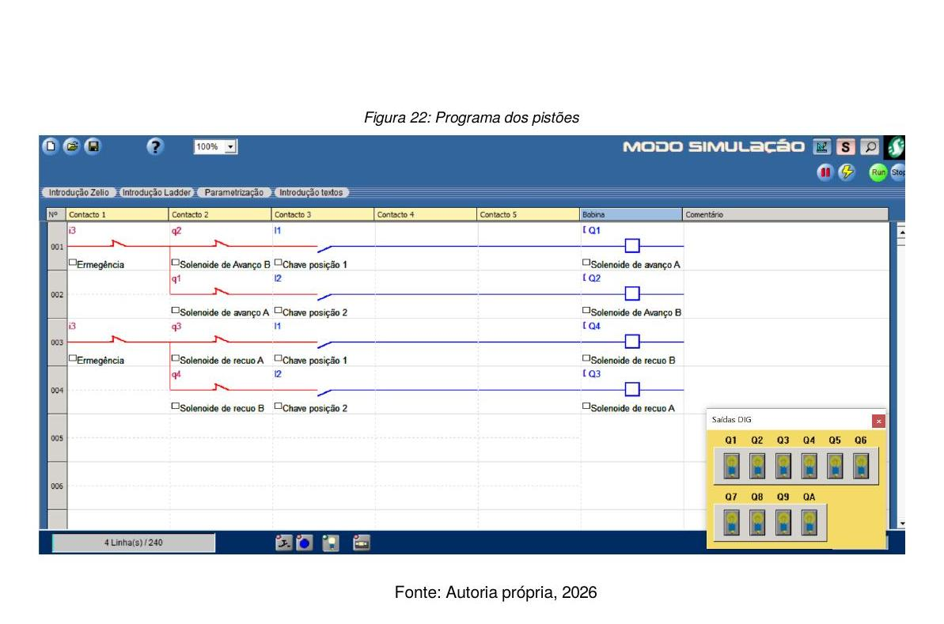
AUTOMATED SYSTEMS II – DIAGRAMS & PLC
Electrical Control Diagram (CadSimu)
PLC Ladder Program (Zelio – Schneider)
H1 = Conveyor OFF | H2 = Conveyor ON | H3 = Motor Overload | Interlock prevents simultaneous UP/DOWN activation

Slide 13
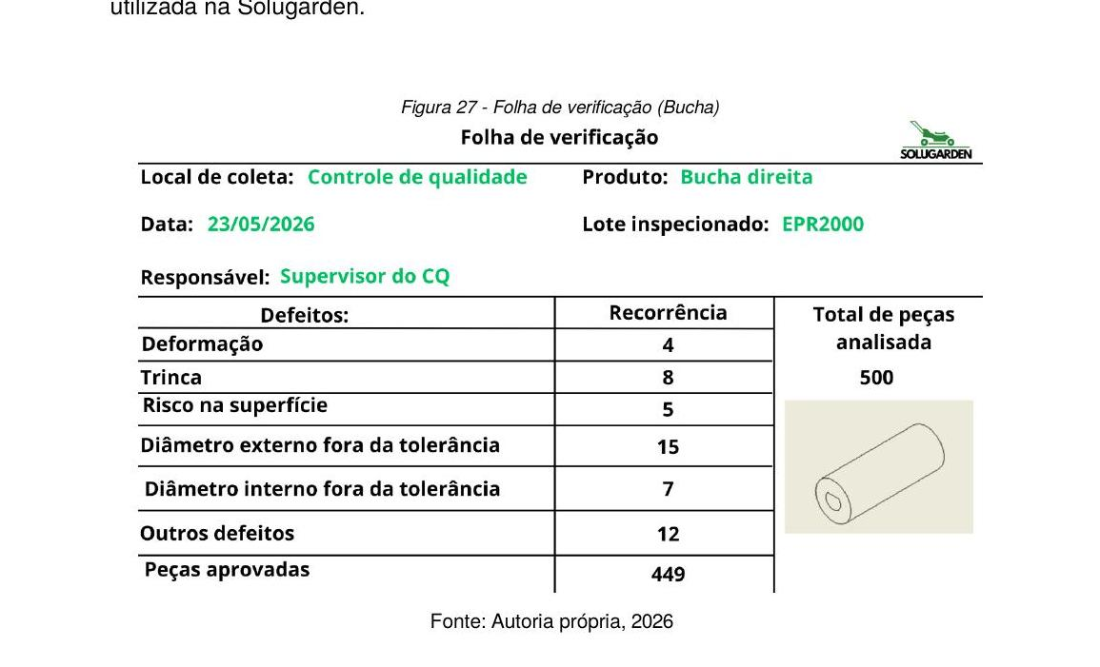
QUALITY CONTROL & PROCESSES
Two real problems identified and addressed with quality tools:
Problem 1 – PowerFlex 755 Inverter
Problem 2 – Bushings with Wrong Thread
Root Cause (5 Whys):
Root Cause (5 Whys):
Lack of review of training content on storage of sensitive electronic components (ESD requirements).
No review/validation of technical drawing with machining department before production start. 100% RH threads produced instead of 50% RH / 50% LH.
PDCA Actions:
PDCA Actions:
✓ ESD area implementation
✓ CNC program correction
✓ Training of inventory employees
✓ Detailed work instruction created
✓ Review of internal procedures
✓ Mandatory engineering–machining review
✓ Temperature & humidity monitoring (20–25°C, 40–60% RH)
✓ Cause & effect verification sheets applied

Slide 14
PDCA CYCLE – CONTINUOUS IMPROVEMENT
P
PLAN
D
DO
Root cause analysis (5 Whys). Action plan: ESD area, employee training, CNC revision, technical drawing update.
Warehouse adapted for ESD/climate control. Employees trained. CNC programs corrected. Non-conforming bushings segregated.
PDCA
A
ACT
C
CHECK
Training added to development plan. Storage procedures standardized. Mandatory technical review before new production batches.
Internal audits: temperature/humidity monitoring. Dimensional inspections of machined bushings. Thread verification.
PDCA enabled Solugarden to eliminate root causes, reduce recurrence risks, and strengthen a culture of continuous improvement.

Slide 15



RESULTS & CONCLUSION
Productivity
Operational Costs
Bakery Lead Time reduced by 39.2%. OEE from 62% → 80%. Monthly inventory turnover more than doubled (+117%).
Lower corrective maintenance with elimination of hydraulic rod jamming. 30% reduction in component replacement costs.
Quality Guaranteed
Validated Automation
PDCA + 5 Whys applied to two real problems — bushings and inverters. Standardized procedures prevent recurrence.
Elevated conveyor with functional PLC and full electrical diagram for robot terrain testing at Solugarden.
DIP V – Advanced Manufacturing | FATEC São Bernardo do Campo | June 2026

Slide 16
THANK YOU
DIP V – Advanced Manufacturing Technology
FATEC São Bernardo do Campo | June 2026
Alecsander • Carlos • Gabriel • Jacson

